Slide 1
Improved Domain Modeling for Realistic Automated Planning and Scheduling in Discrete Manufacturing

Slide 2
Abstract
Current production planning and scheduling systems in automation do not meet the requirements of modern individualized production.
（现有的自动化生产中的规划和调度系统不适合现代个性化生产的要求）
Model the manufacturing system and products in a way that automated planners can generate efficiently process plans and schedules
（以规划器能够有效生成流程计划和进度表的方式对制造系统和产品进行建模）
Based on a general classification of operations, different modeling options with regard to a successful automated process planning and scheduling are discussed. As a result, a domain modeling approach for discrete manufacturing is presented.
（基于对操作的分类建立不同的模型进行讨论，提出一种用于离散制造的领域建模方法）

Slide 3
I. Motivation
II. State of the art
III. A classification of operations in discrete manufacturing
IV. A modeling approach of manufacturing planning problems
V. Evaluation
VI. Summary and further work

Slide 4
I. Motivation
Smart factories （智能工厂）are the vision of Industrie 4.0 .Cyber Physical Production Systems (CPPSs网络物理生产系统) are technical enablers and a key technology for smart factories.（adaptability and self-organization）
Customized （定制）manufacturing and small-scale production are the trend in modern manufacturing industry.（complicated）
Traditionally, manufacturing process planning and scheduling are two separated tasks. Production processes of manufacturing systems are manually （人工）implemented in static control systems.
Modern：An automated integrated process planning and scheduling on control level to establish a dynamic control software. Process planning and scheduling merge and based on customer-specific orders（订购）, production processes are planed and scheduled automatically.

Slide 5
Essential prerequisite（前提条件） for the successful application of existing algorithms in AI planning is the modeling of the CPPS, the individual modules and their skills, and the ordered products as manufacturing planning problem.
Focus of this paper is the development of an appropriate modeling concept initially for discrete manufacturing. （为离散制造开发适当的建模概念）
Planning domains are large heterogeneous（异构） systems consisting of different modules（不同的模块）, e.g. transport and production modules. A range of dependencies（依赖关系）, e.g. between modules, exists and needs to be appropriately modeled in order to prevent the generation of wrong production processes.

Slide 6
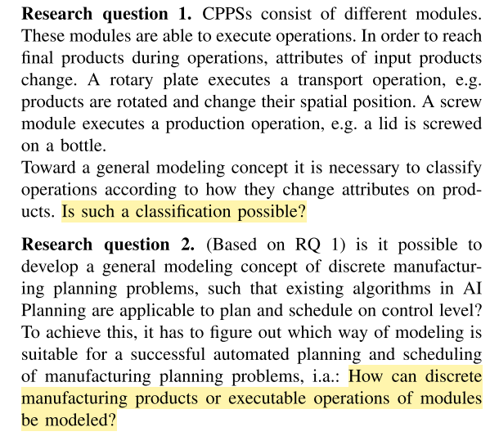

Slide 7
II. State of the art
The development of PDDL.
Although PDDL and its extensions（拓展） were developed to solve real world problems, the application of automated planning and scheduling in manufacturing is rare.
Applications focus on process planning and not on scheduling. They are simplified planning problems and do not solve real world manufacturing planning problems.（应用侧重于流程规划，而不是调度。它们只是简化的规划问题，并不能解决现实世界的制造规划问题）
the RoboCup Logistics League (RCLL) :The challenge of the robots is “to plan, execute, and optimise the material flow in a smart factory scenario and deliver products according to dynamic orders.”（机器人“在智能工厂场景中规划，执行和优化物流，并根据动态订单交付产品）The goal is not a general production planning and not an efficient automated planning and scheduling of product orders.
A general approach of automated planning and scheduling in production planning does not yet exist in automation.

Slide 8
III. A classification of operations in discrete manufacturing
Discrete manufacturing is “the production of distinct items such as automobiles, appliances or computers.”
Discrete manufacturing input, intermediate and end products are clearly identifiable.（离散制造输入，中间产品和最终产品清晰可辨）
A successful automated discrete manufacturing process planning and scheduling assumes the description of the manufacturing system, the individual modules and their skills, and the specification of ordered products.（定义了制造系统、各个模块及其功能以及订购产品的规格。）
A suitable criterion to classify the different processes on a product during the production process is the change of attributes. For example, during a transport operation not the product itself, but its spatial position changes.

Slide 9
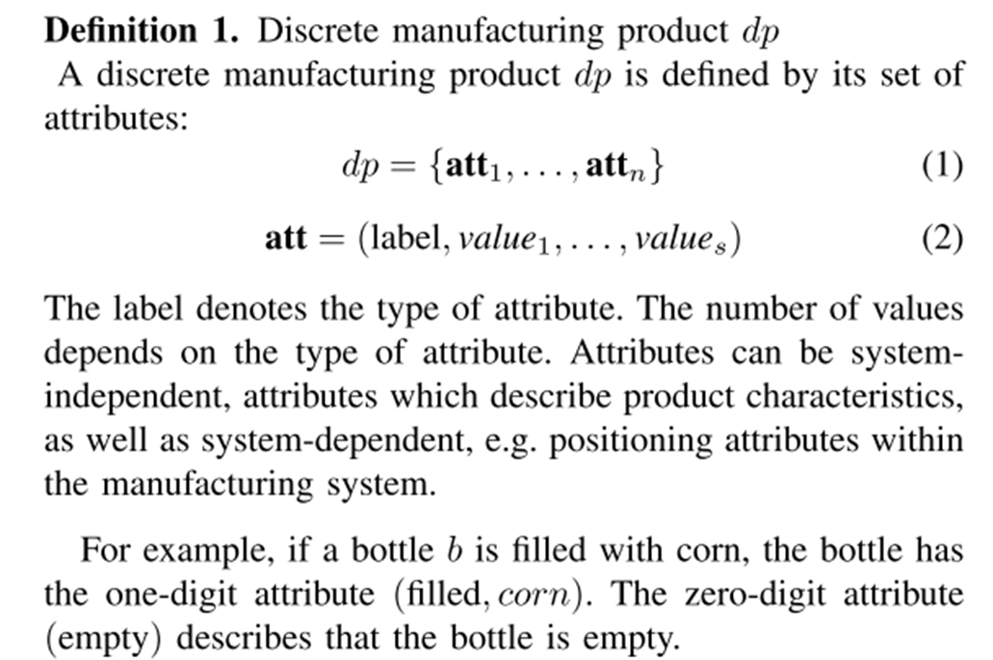

Slide 10
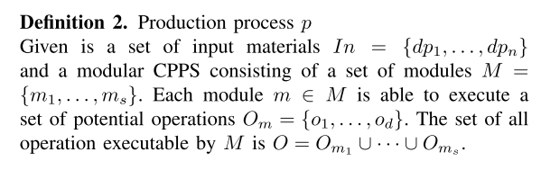
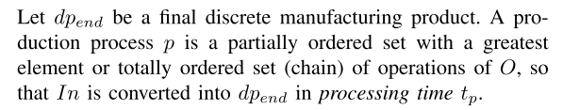

Slide 11
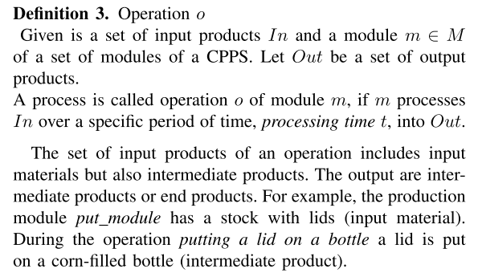

Slide 12
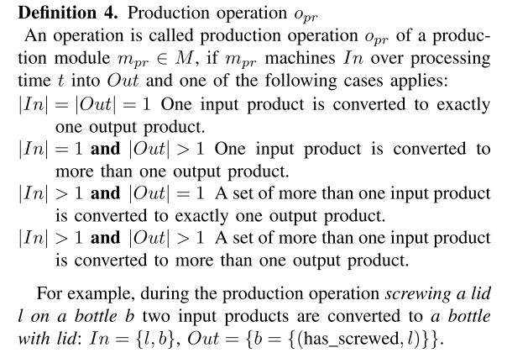

Slide 13
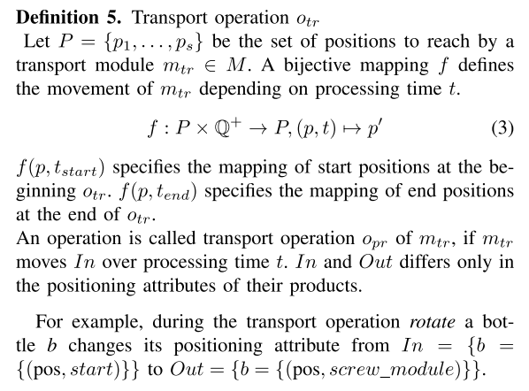

Slide 14
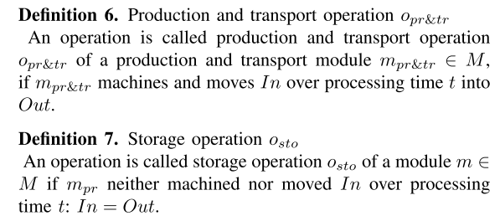

Slide 15
IV. A modeling approach of manufacturing planning problems
A. Domain and problem modeling
The domain of a manufacturing planning problem describes the manufacturing system: All possible operations executable by the different modules of the system.
The problem of a manufacturing planning problem describes all information of day-to-day production: The current state of the system and the ordered products.

Slide 16
In the general approach information about the specific system structure is part of the problem description. Operations are described generally by means of parameters. E.g. a transport operation of a transport module determines the possible posi- tions to reach, but does not define, which module is connected to which position.
This approach has the disadvantage that with increasing number of variables the search space grows and automated planners fail to solve the planning problem
In a specific modeling approach the operations in the domain entail specific knowledge about the manufacturing system. Constants rather than parameters are used to model the operations. If the technical system is frequently modified, a specific modeling requires a certain modeling effort in case of changes. But beyond that a specific modeling approach increases the efficient generation of plans/schedules by automated planner

Slide 17
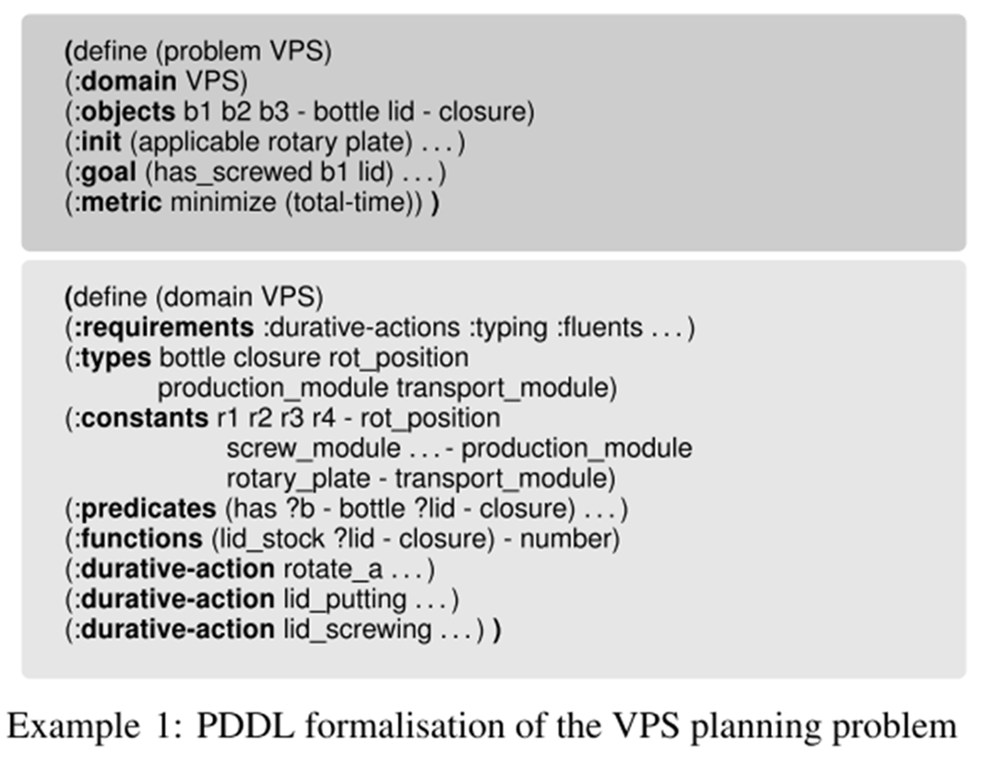
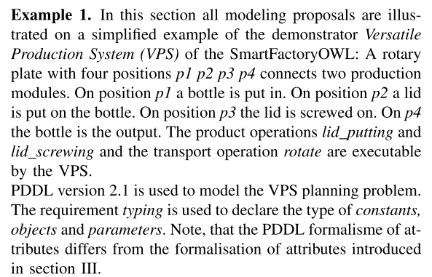

Slide 18
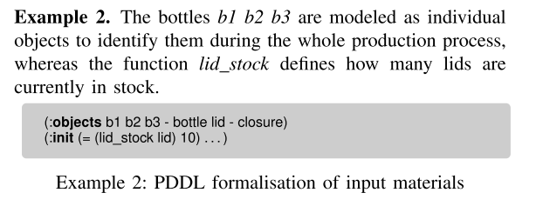
B. Problem modeling
Input materials

Slide 19
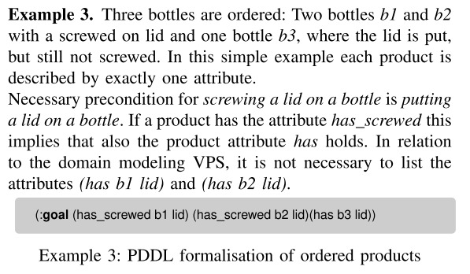
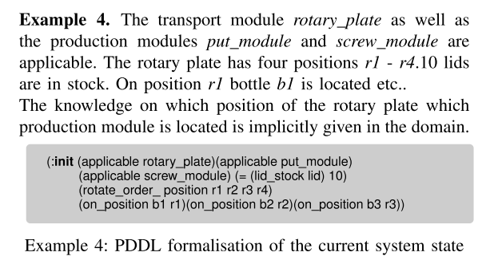
Ordered products
Current state of the manufacturing system

Slide 20
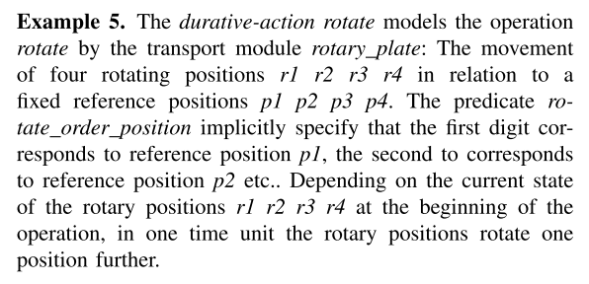
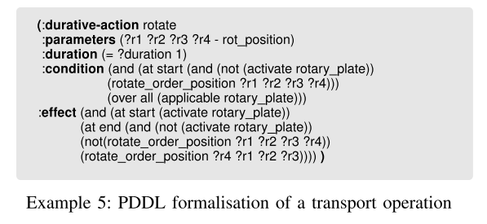
C. Domain modeling
Transport operation

Slide 21
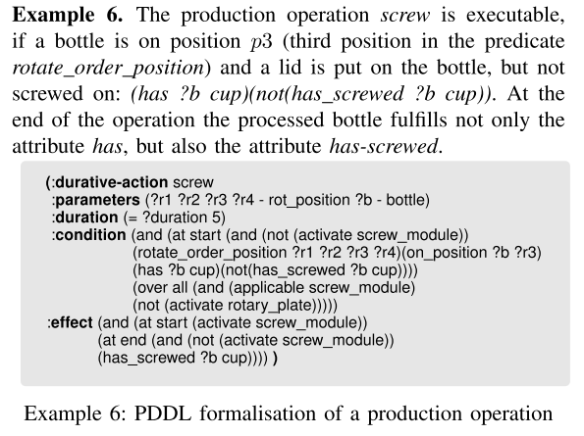
Production operation

Slide 22
V. Evaluation
The planning domain consists of a rotary plate with 12 positions, a water filling module, a corn filling module, a cap putting and a cap screwing module, all connected to the rotary plate. The planning system Temporal Fast Downward (TFD) , participating planner on the IPC 2014, is used on a mac- BookPro 2015, 2,2GHz i7, 16 GB to solve the VPS planning problem. The optimisation criterion of TDF is to minimise the makespan (maximum completion time). Three approaches of modeling the planning domain were evaluated.

Slide 23
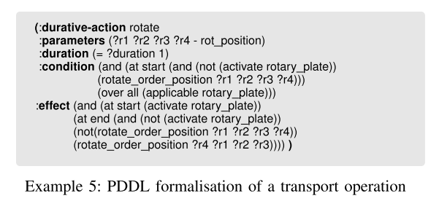
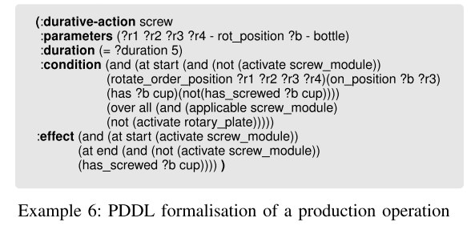
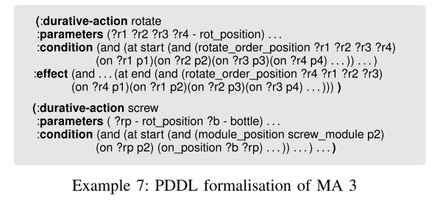
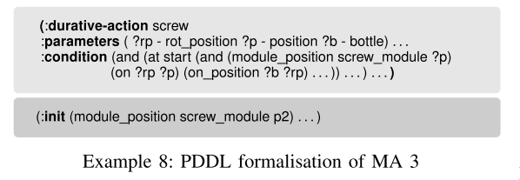

Slide 24
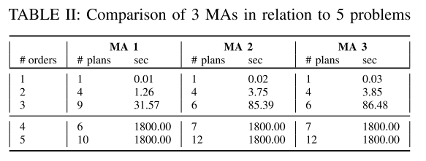
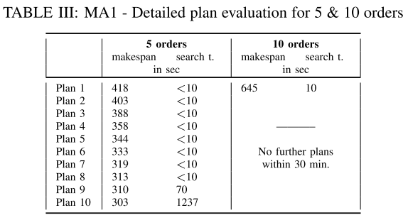

Slide 25
VI. Summary and further work

